Slide 1
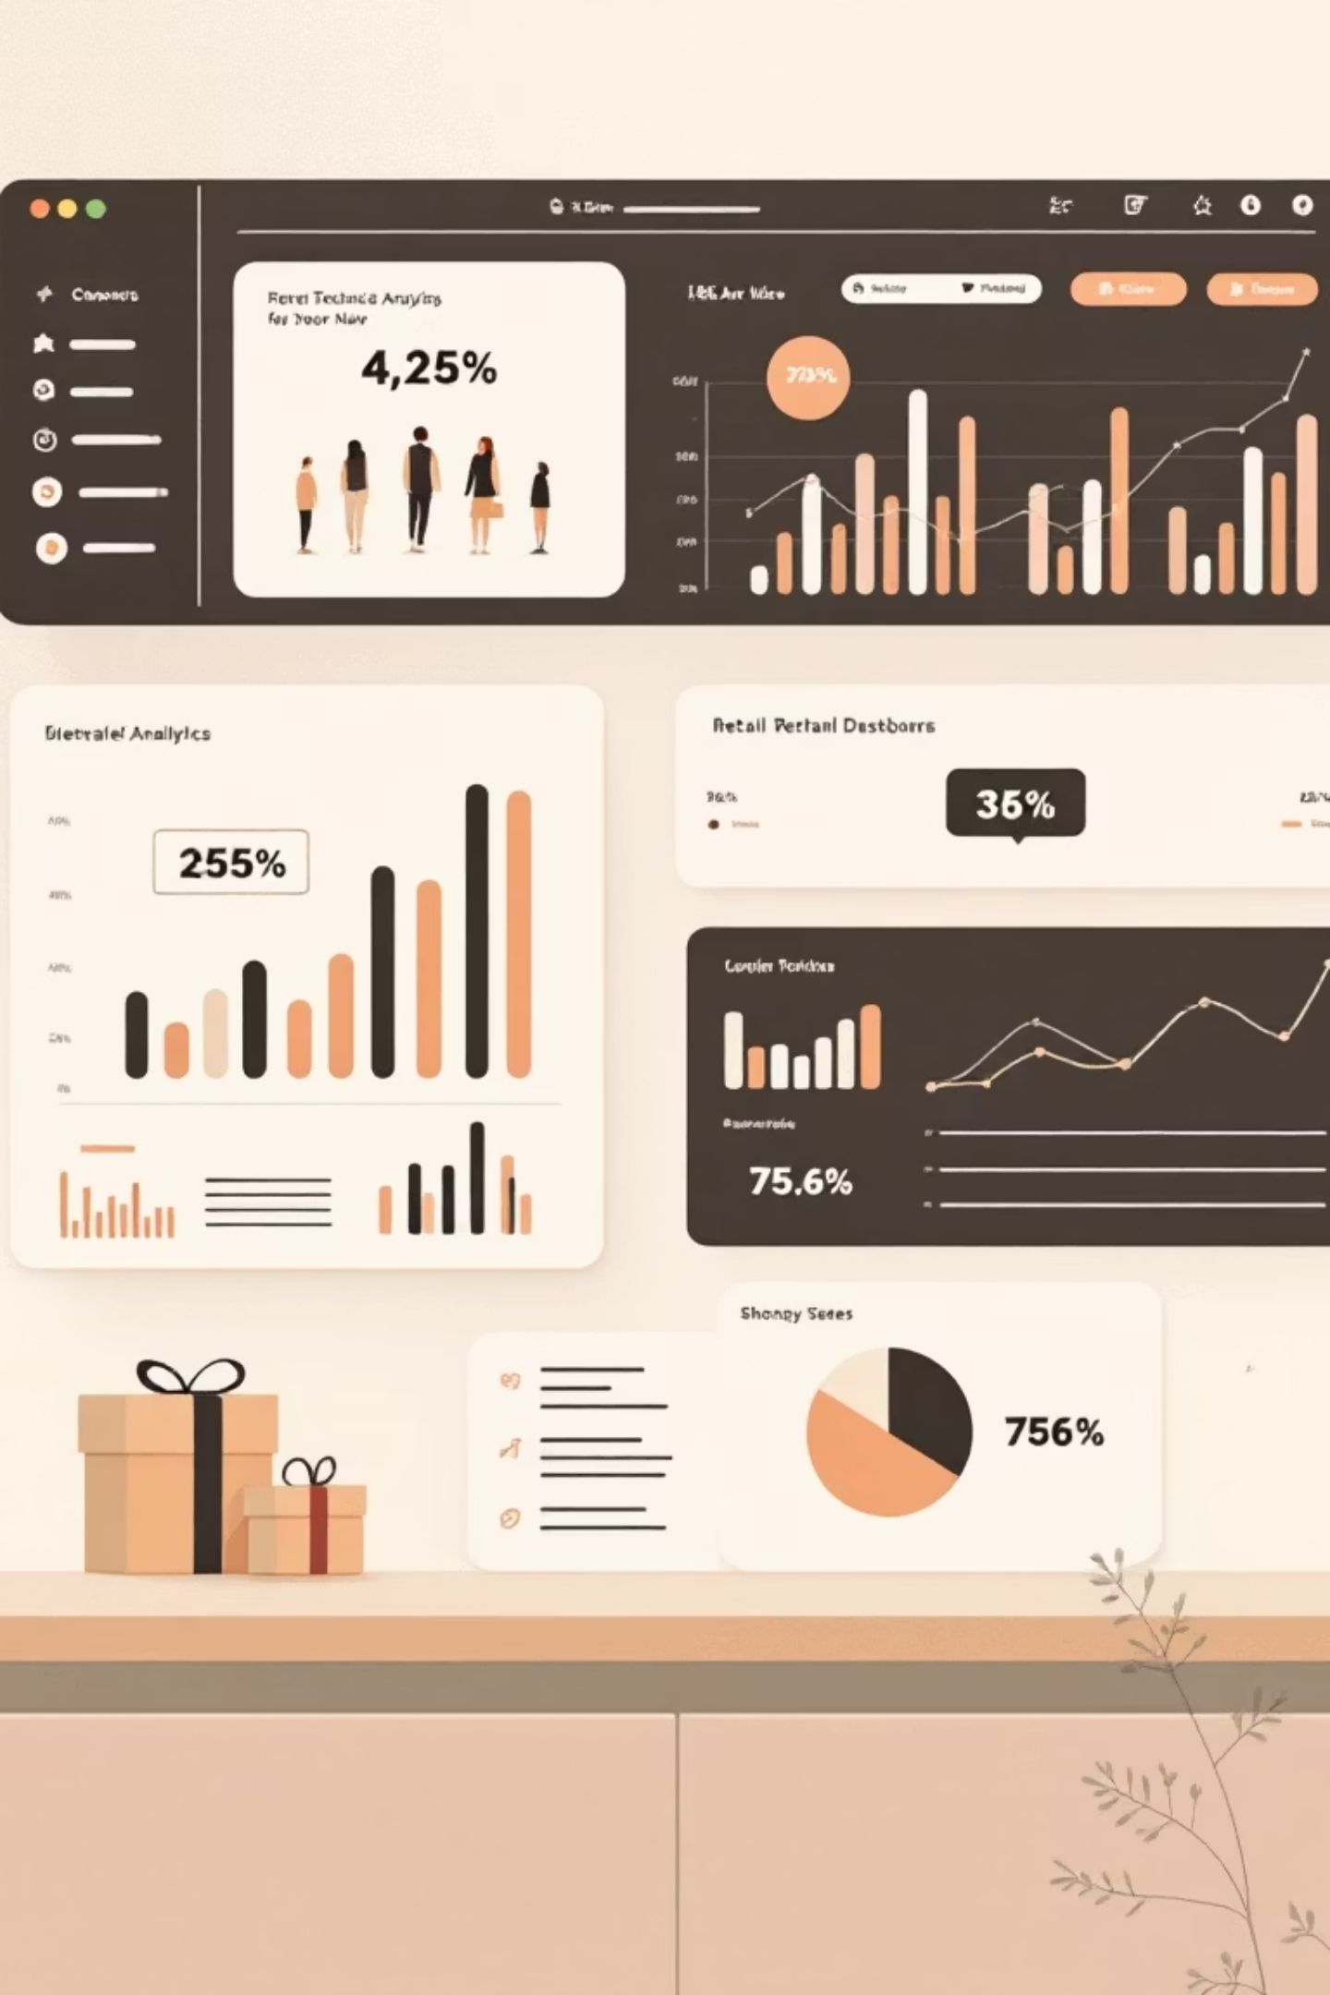
Customer Shopping Behavior Analysis
Uncovering insights from 3,900 purchases to guide strategic business decisions

Slide 2

OVERVIEW
Dataset at a Glance
3,900
18
50
Total Purchases
Data Points
Locations
Transactions analyzed across all categories
Features tracked per customer
Geographic coverage
25
Products
Unique items purchased

Slide 3

DATA PREPARATION
Python Analysis Pipeline
01
Data Loading & Exploration
Imported dataset, checked structure with pandas
02
Missing Data Handling
Imputed 37 missing review ratings using category medians
03
Feature Engineering
Created age groups and purchase frequency metrics
04
Database Integration
Loaded cleaned data into PostgreSQL for analysis

Slide 4
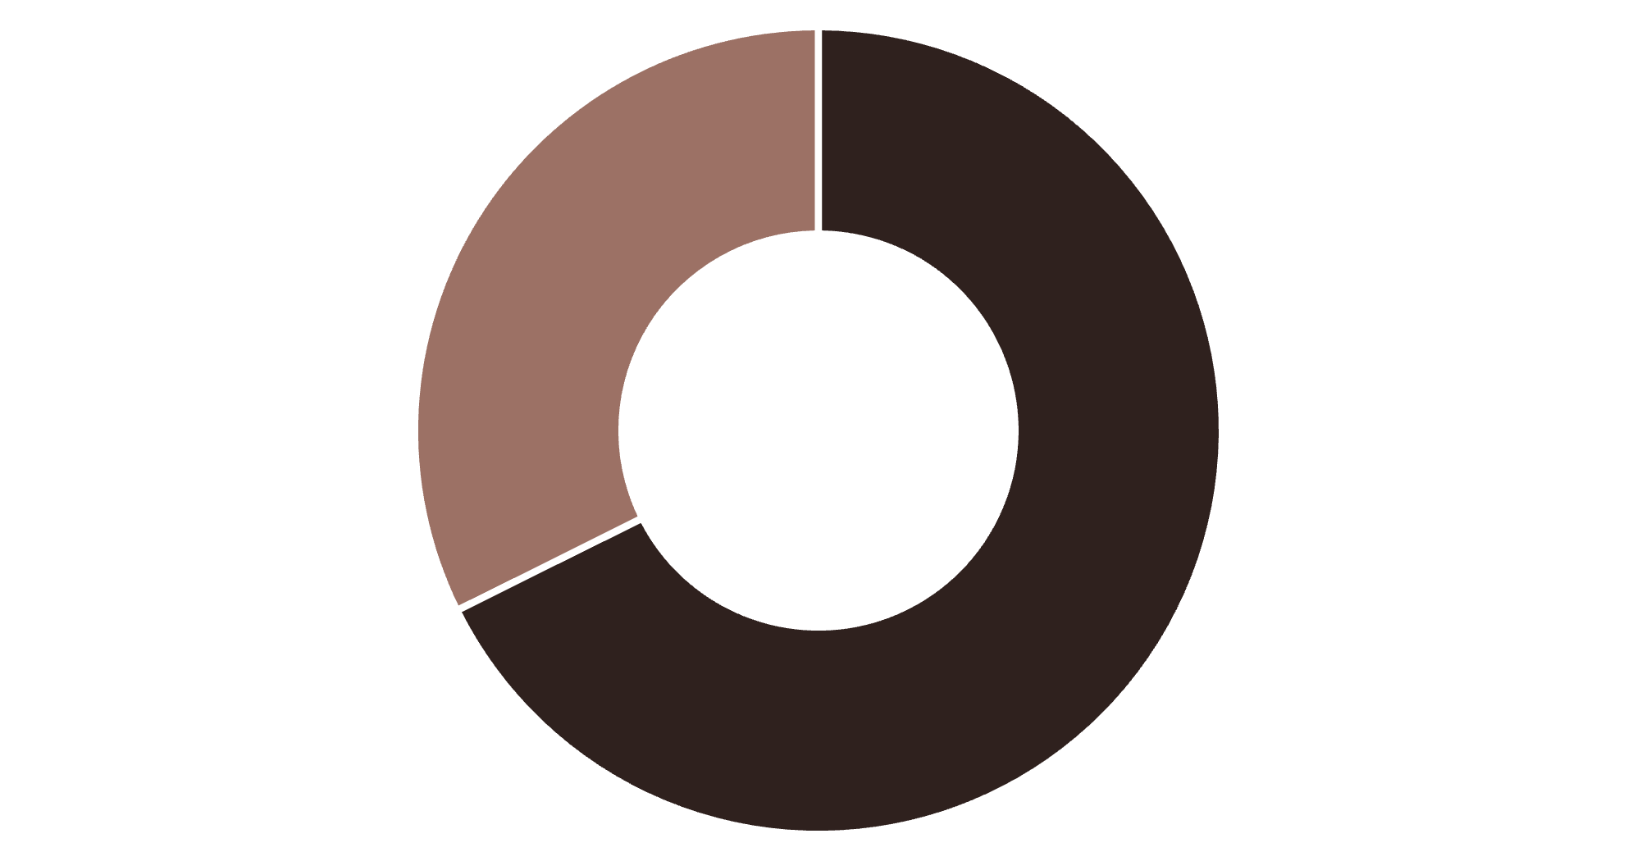
KEY INSIGHTS
Revenue by Gender
Male Dominance
Male customers generate 68% of total revenue, significantly outpacing female shoppers
Strategic opportunity for targeted campaigns
Male
Female

Slide 5
Top Products by Customer Rating
77%
77%
76%
Gloves
Sandals
Boots
Highest rated at 3.86 stars
Strong performance at 3.84 stars
Solid rating of 3.82 stars
76%
76%
Hat
Skirt
Consistent at 3.80 stars
Reliable at 3.78 stars

Slide 6




Customer Segmentation Breakdown
Returning
701 customers (18%)
Growth opportunity segment
Loyal Customers
3,116 customers (80%)
Backbone of revenue stream
New Customers
83 customers (2%)
Fresh acquisition pipeline

Slide 7

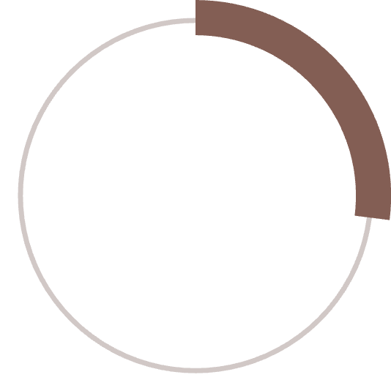

SUBSCRIPTION ANALYSIS
Subscribers vs Non-Subscribers
Subscription Status
Spending Patterns
Subscribers: $59.49 avg spend
Non-subscribers: $59.87 avg spend
Minimal difference suggests untapped subscription value
27%
Opportunity: Enhance subscriber benefits
Subscribers
1,053 customers
73%
Non-Subscribers
2,847 customers

Slide 8
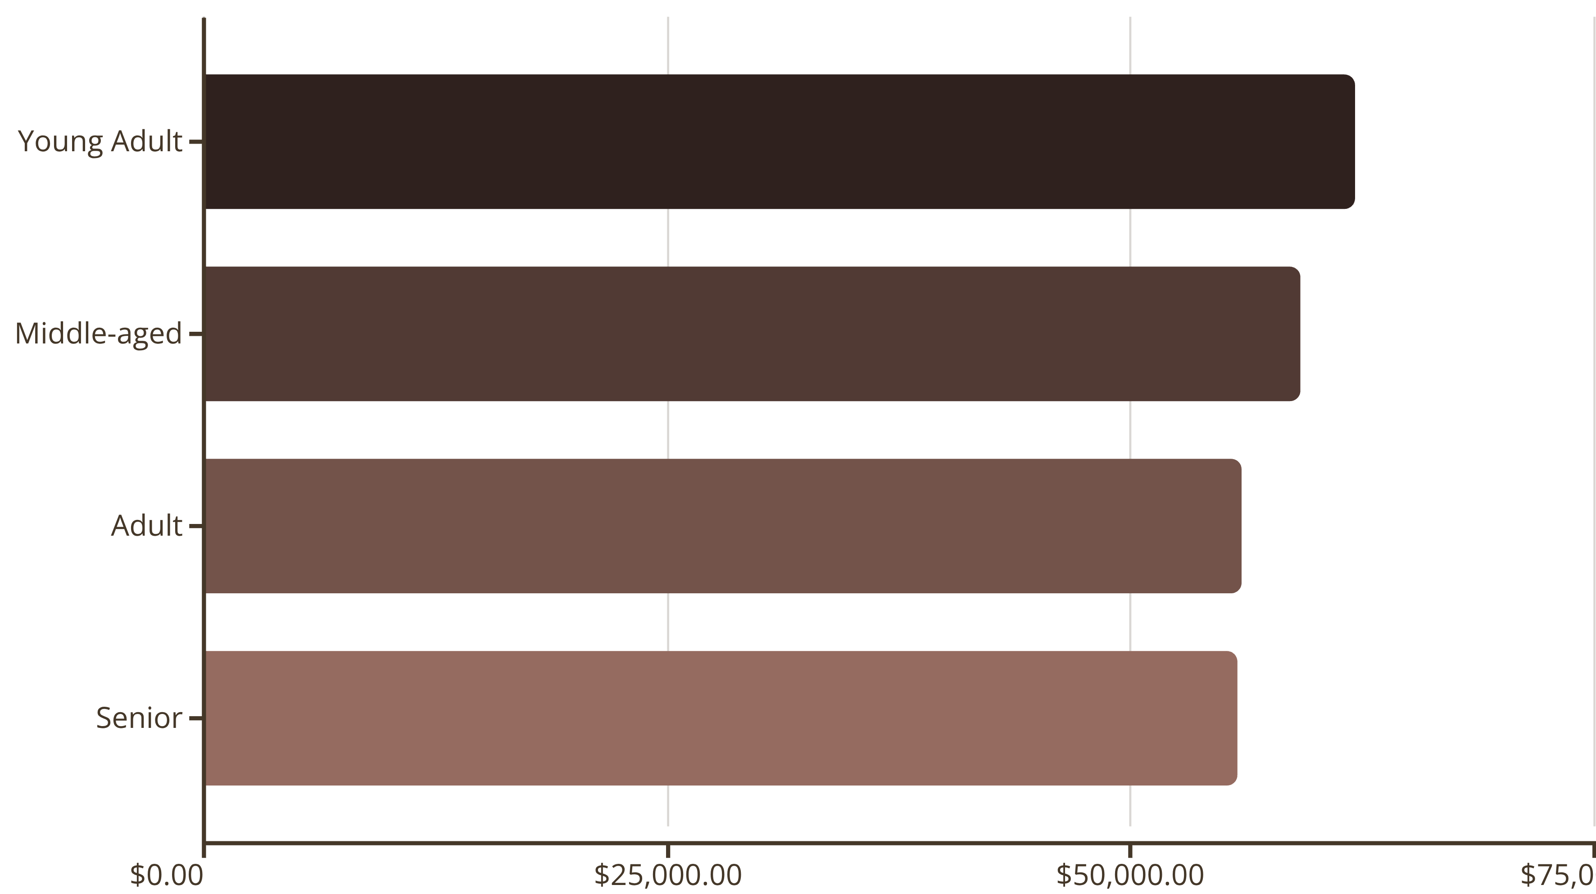
Revenue Distribution by Age Group
Young adults lead revenue generation, but all segments show balanced contribution

Slide 9
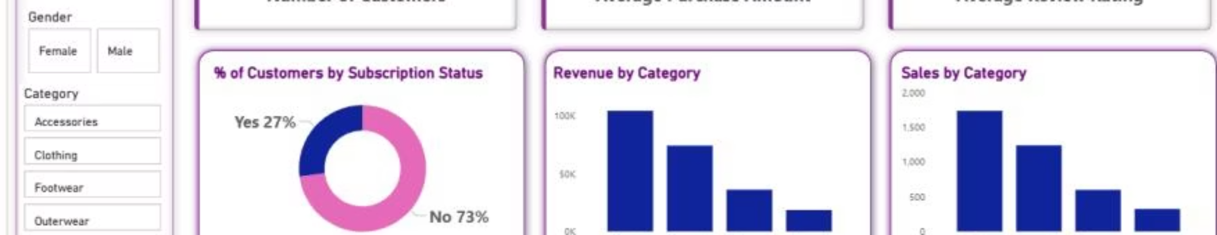
DASHBOARD
Power BI Interactive Dashboard
Key Metrics
Dynamic Filters
Visual Insights
3.9K customers, $59.76 avg purchase, 3.75 rating
Subscription, gender, category, shipping type
Revenue and sales by category and age group

Slide 10
ACTION PLAN
Strategic Recommendations
Boost Subscriptions
Loyalty Programs
Review Discount Policy
Promote exclusive benefits to convert 73% non-subscribers
Reward repeat buyers to strengthen 80% loyal segment
Balance sales growth with margin protection
Product Positioning
Targeted Marketing
Highlight top-rated items like gloves and sandals
Focus on high-revenue age groups and express shipping users

